Slide 1
Chapter 12:
The Map Abstract Data Type
Data Structures in Java: From Abstract Data Types to the Java Collections Framework
by Simon Gray

Slide 2
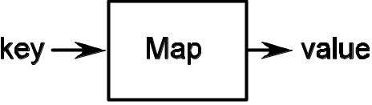
Introduction
Examples of Map usage:
  concordance – a list of words that appear in a text along with how frequently the word appears and the page/line numbers on which it appears
  book index – ordered collection of key words along the page numbers on which the word appears
  symbol table – a compiler data structure associating identifiers with declaration information
A map is a collection type that stores ⟨key, value⟩ pairs. In a key-based collection, there is no sense of “where” a value is stored. A value is retrieved by supplying the map with the associated key.
12-<number>

Slide 3
Map Description, Properties & Attributes
Description
A map stores <key, value> pairs. Given a key, a map provides the associated value. The types of the key and value are not specified, but it must be possible to test for equality among keys and among values.
Properties
1. Duplicate keys are not allowed.
2. A key may be associated with only one value.
3. A value may be associated with more than one key.
4. Keys can be compared to one another for equality; similarly for values.
5. Null keys and values are not allowed.
Attributes
size: The number of <key, value> pairs in this map.
12-<number>

Slide 4

Map Operations
Map()
pre-condition: none
responsibilities: constructor—create an empty map
post-condition: size is set to 0
returns: nothing
put( KeyType key, ValueType value )
pre-condition: key and value are not null
key can be compared for equality to other keys in this map
value can be compared for equality to other values in this map
responsibilities: puts the <key, value> pair into the map. If key already exists in this map, its value is replaced with the new value
post-condition: size is increased by one if key was not already in this map
returns: null if key was not already in this map, the old value associated with key otherwise
exception: if key or value is null or cannot be compared to keys/values in
this map
12-<number>

Slide 5
Map Operations
get( KeyType key )
pre-condition: key is not null and can be compared for equality to other keys in this map
responsibilities: gets the value associated with key in this map
post-condition: the map is unchanged
returns: null if key was not found in this map, the value associated with key otherwise
exception: if key is null or cannot be compared for equality to other keys in this map
remove( KeyType key )
pre-condition: key is not null and can be compared for equality to other keys in
this map
responsibilities: remove the value from this map associated with key
post-condition: size is decreased by one if key was found in this map
returns: null if key was not found in this map, the value associated with
key otherwise
exception: if key is null or cannot be compared for equality to other keys in
this map
12-<number>

Slide 6
Map Operations
containsValue( ValueType value )
pre-condition: value is not null and can be compared for equality to other values in this map
responsibilities: determines if this map contains an entry containing value
post-condition: the map is unchanged
returns: true if value was found in this map, false otherwise
exception if value is null or cannot be compared for equality to other values in this map
containsKey( KeyType key )
pre-condition: key is not null and can be compared to other keys in this map
responsibilities: determines if this map contains an entry with the given key
post-condition: the map is unchanged
returns: true if key was found in this map, false otherwise
exception: if key is null or cannot be compared for equality to other keys in
this map
12-<number>

Slide 7
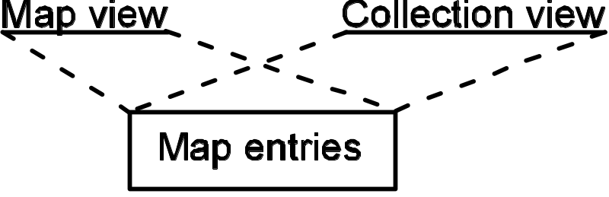
Map Operations
values()
pre-condition: none
responsibilities: provides a Collection view of all the values contained in this map. The Collection supports element removal, but not element addition. Any change made to the Collection is reflected in this map and vice versa
post-condition: the map is unchanged
returns: a Collection providing a view of the values from this map
A Collection view is a different way to “view” the entries stored in the map
12-<number>

Slide 8
A Test Plan for Map
As before, use predicate and accessor methods to verify state changes from mutators
Some examples:
  put a ⟨key, value⟩ pair in an empty map; given the key, should get the value back
  put a ⟨key, value⟩ pair in an empty map, then put in another pair using the same key but a different value, the original value should be returned
  A value can be associated with more than one key. The map should regard these as separate entries, so attribute size should be 2. contains() should verify that the map contains the two keys and the value, and get() on the two keys should return equal values
12-<number>

Slide 9
Hashing and Hash Tables - Motivation
Problem: Indexed access in a collection is only fast when you know the index of your target. Without the index, you have to search
  O(n) if the collection isn’t sorted, O(log₂n) if it is
Idea: What if we could use the search key (the target) as an index into the collection to take us directly to the associated value? O(1) search time!
12-<number>

Slide 10
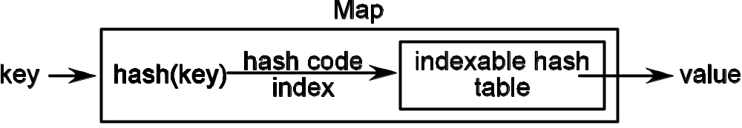
Hashing and Hash Tables
A hash table is an indexable collection.
Each position in the hash table is called a bucket and can hold one or more entries.
A hash function converts an entry’s key into an index that is used to access a bucket in the hash table.
12-<number>

Slide 11
Hashing and Hash Tables - Complications
The Good: If each key maps to a unique position in the hash table, then most hash table operations (insertion, removal, and retrieval) will have a run time of O(1)
The Bad: To guarantee O(1), the table would have to have as many buckets as there are possible keys.
  Since the range of keys may be quite large (think of nine-digit Social Security numbers, 10-digit telephone numbers, or seven-digit university ID numbers), this is not practical
Idea: work with an approximation to the ideal
  allow the hash table to have m buckets (m may be << key range)
  allow the hash function to hash more than one key to the same bucket. When this happens, we have a collision
  now we need strategies for dealing efficiently with collisions
12-<number>

Slide 12
Collision Resolution Strategies
open addressing
  each bucket can contain only a single entry
  when a collision occurs, we must find a bucket at another position in the table to store the entry.
  we “open up” the table and allow the entry to be stored in a bucket other than the one to which it originally hashed (its primary hash index)
  example strategy : linear probing (also called open linear addressing)
12-<number>

Slide 13
Collision Resolution Strategies
closed addressing
  an entry must be stored at the position (bucket) to which it originally hashed.
  the strategy here is to allow the bucket capacity to be greater than 1. Thus each bucket is itself a collection (hopefully small).
  example strategy: chaining
12-<number>

Slide 14
Open Addressing: Linear Probing
Idea: a collision occurs at position i and a different bucket must be found for the entry
  try the position at (i + 1); if that is occupied, try (i + 2) and so on, wrapping around when the table end is reached
  this is called linear probing
Complications:
  primary clustering
  secondary clustering
  remove operations
12-<number>

Slide 15
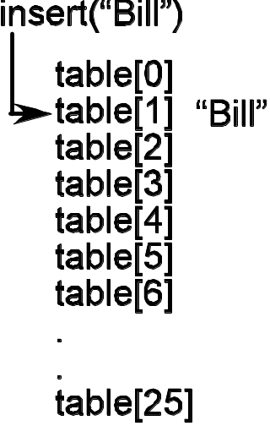
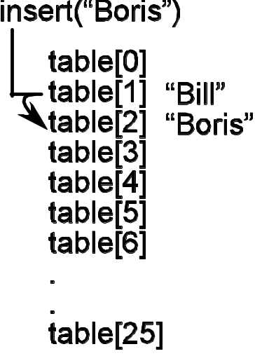
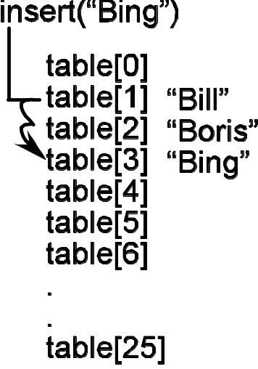
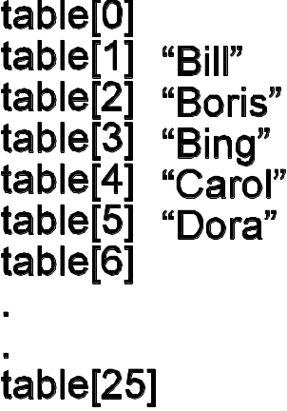
Linear Probing – Clustering
(a) Inserting “Bill” – there is no collision
(b) Inserting “Boris” – there is a collision at position 1
(c) Inserting “Bing” – there are collisions at positions 1 and 2
(d) After inserting “Carol” then “Dora”, producing secondary cluster collisions
primary clustering – when several keys hash to the same position and end up taking adjacent buckets
secondary clustering – a key hashes to a position to find it taken by a victim of primary clustering
12-<number>

Slide 16
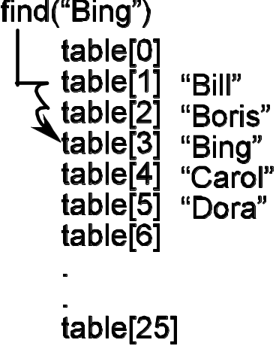
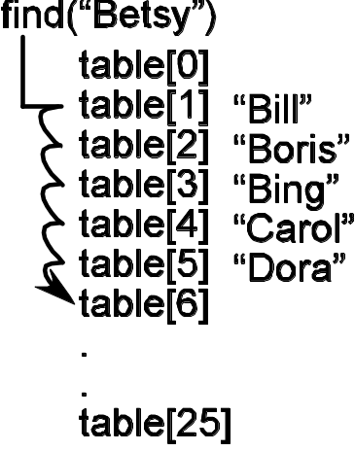
Linear Probing - Searches
Hash to key’s hash position, then do a linear search until either the key is found (success) or an empty bucket is found (failure)
we revisit this shortly!
(a) Finding “Bing” requires three probes before succeeding
(b) Finding “Betsy” requires six probes before failing
12-<number>

Slide 17
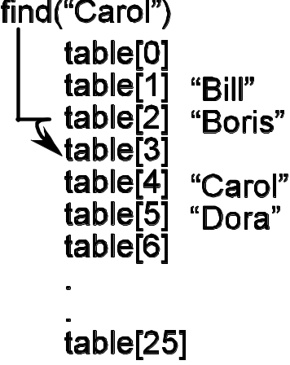
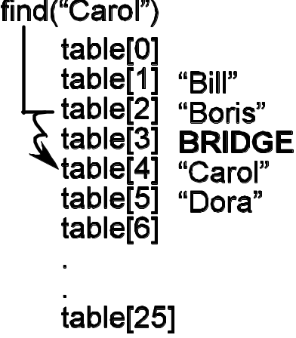
Linear Probing - Deletions
Remember how a search is done?
Clustering complicates things since a remove operation since it can cause a gap in entries forced to be adjacent due to collisions
(a) With “Bing” deleted, there is a gap at position 3, so a probe beginning in position 2 fails when it encounters the gap
(b) With a bridge in the place “Bing” occupied, the probe correctly advances to position 4
12-<number>

Slide 18
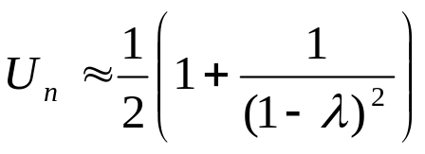
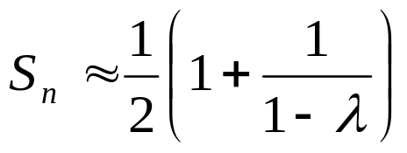
Analysis of Linear Probing
The load factor, λ, of a hash table is the number of entries the table stores divided by the number of buckets in the table
Focus on cost of a search since all operations depend on it
Unsuccessful search
Successful search
12-<number>

Slide 19
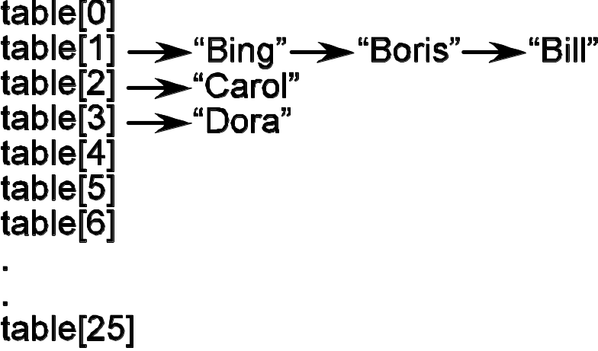
Closed Addressing: Chaining
With Open Addressing we allowed an entry to be stored in a bucket other than the one to which is hashes
With Closed Addressing we require that an entry only be stored in the bucket to which it hashes
Requires that buckets by allowed to store more then one entry
  ⇒ chain them together!
12-<number>

Slide 20
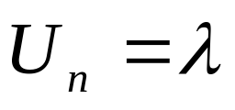
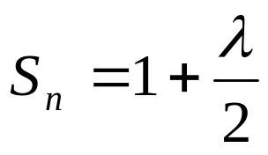
Analysis of Chaining
Cost depends on the length of a bucket’s chain
Worst case? All the entries hash to the same bucket! O(n)!
Average case? If the hash function evenly distributes the keys over the buckets, each chain will have λ = n/m
Unsuccessful search
Successful search
12-<number>

Slide 21
Hashing Functions
A hash function has three important requirements:
Deterministic – A hash function must always produce the same hash value each time it is given the same key
Efficient – Every access to the table requires hashing a key, so it is important to the table’s performance that the hash value be simple to compute
Uniform – The treasured O(1) access time is only realized if the hash function distributes the keys uniformly over the hash table. A poor hash function will promote clustering, which hurts performance
12-<number>

Slide 22
Hashing Functions – String to Integer
Converting a string to an integer – treat the characters as digits; multiply their integer equivalent by a prime raised to the power of its digit position
J a v a
74 * 31³ + 97 * 31² + 118 * 31¹ + 97 * 31⁰
12-<number>

Slide 23
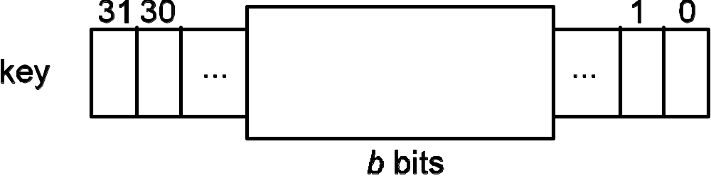
Hashing Functions – Mid-square
Mid-square – convert the key to an integer, then square it. Create the index from a group of b bits from the middle of the resulting integer such that 2^{b} = m, the number of buckets in the table
12-<number>

Slide 24
Hashing Functions - Folding
Folding – break up the key into same-sized groups and combine using addition, multiplication, or a logical operator
Step 1: Fold
Step 2: Convert back to base 10
Win
che
ste
r
1 1
87 105 110
+ 99 104 101
+ 115 116 101
+ 0 0 114
1 46 70 170
(base 256)
1 * 256³ + 46 * 256² +
70 * 256¹ + 170 = 19,810,062
12-<number>

Slide 25
Hashing Functions – For a Collection
Hashing a collection is different than hashing a scalar value
Problem rests with the notion of “equality”
  contracts for equals() and hashCode() from Object say that two equal objects should have the same hash code
When are two collections “equal”?
  When they store the same elements?
  When they store the same elements in the same order?
12-<number>

Slide 26
Hashing in Java
Character – the character’s underlying integer representation
Float – the bits that represent the floating-point number interpreted as an integer
Integer – the Integer’s int value
String – folding; the sum of the int values of each character in the String multiplied by 31, raised to the power of the character’s position in the String
ArrayList – folding; the sum of the hash values of each element in the List multiplied by 31 raised to power of the element’s position in the List
12-<number>

Slide 27
HashMap: A Hash Table Implementation
HashMap Implementation Tasks
Represent an Entry in a Map with Entry and LinkEntry
Identify HashMap data fields
Implement put()
Implement containsKey() and containsValue()
Implement values() – provide a Collection view of the map
Implement HashMapIterator – very interesting!
12-<number>

Slide 28
Entry and LinkEntry
The Entry class stores a ⟨key, value⟩ pair
Note in the class header (next slide) we specify two formal type parameters, one for the type of the key and one for the type of the value
Class LinkEntry extends Entry and provide a way to chain entries together
  Why not just put the link in the Entry class?
12-<number>

Slide 29
The Entry Class
3 public class Entry <K, V> implements java.io.Serializable {
4 private K key;
5 private V value;
6
7 public Entry(){
8 key = null;
9 value = null;
10 }
11
12 /**
13 * Create an entry for key <tt>k</tt> and value <tt>v</tt>.
14 * @param k the key for this entry
15 * @param v the value associated with key <tt>k</tt>
16 * for this entry
17 * @throws <IllegalArgumentException> if either <tt>k</tt> or
18 * <tt>v</tt> is <tt>null</tt>
19 */
20 public Entry( K k, V v ) {
21 if ( ( k == null ) || ( v == null ) )
22 throw new IllegalArgumentException( “null argument” );
23 this.key = k;
24 this.value = v;
25 }
two formal type parameters
one for the type of the Key
one for the type of the Value
12-<number>

Slide 30
Identify HashMap data fields – comments first
The iterator constants are used to identify the kind of iterator that is created. This is presented in a later Task; the basic idea is that we can implement a single iterator that can be configured at the time of instantiation to return different kinds of map entities
MAX_LOAD_FACTOR is the maximum load factor the table can support before performance really degrades and the table is resized
The first time values() is called, a Collection object will be created for that view and returned to the caller. Since the Collection is backed by the map, subsequent calls to values() will return the existing Collection view. That is, we don’t want/need to create a new Collection view for each call to values().
12-<number>

Slide 31
Identify HashMap data fields
public class HashMap<K, V>
implements Map<K, V>, java.io.Serializable {
//Fields used to determine the type of iterator created.
private static final int KEY_ITERATOR = 0;
private static final int VALUE_ITERATOR = 1;
private static final int ENTRY_ITERATOR = 2;
// default capacity for the table
private static final transient int DEFAULT_CAPACITY = 11;
// load factor determining when the table gets resized
private static final transient float MAX_LOAD_FACTOR = .70f;
private LinkEntry<K, V> table[]; // the hash table!
private int capacity; // the table’s current capacity
private int size; // # of entries in the table
// the view, if it exists – only need to create it once
private Collection<V> collectionView = null;
protected transient int modCount; // for fail-fast iteration
With minimal
commenting!
12-<number>

Slide 32
Implement put()
Note use of the formal type parameters
here and elsewhere in the method
public V put( K key, V value ) {
if ( ( key == null ) || ( value == null ) ) // check pre-conditions
throw new IllegalArgumentException( "null argument" );
// see if we have exceeded the table’s load factor
if ( ( (float) this.size / this.capacity ) >= this.MAX_LOAD_FACTOR )
this.resize();
this.modCount++; // to help make the iterator fail-fast
// hash into the table, then search the chain looking for the key
int hashIndex = getHashIndex( key );
LinkEntry<K, V> entry = find( this.table[hashIndex], key ); // utility method
// if we hit the end of the chain, the key isn't already in the
// table, so put this new entry at the head of the chain
if ( entry == null ) {
entry = new LinkEntry<K, V>( key, value, this.table[hashIndex] );
this.table[hashIndex] = entry;
this.size++;
return null; // indicates this is a new entry
}
else { // key is in the table, so replace its value field
V tempValue = entry.value();
entry.setValue( value );
return tempValue; // indicates parameter value replaces the old value
}
}
12-<number>

Slide 33
Implement containsKey()
Since a map is key-based, the implementation is straightforward
⇒ hash to the key’s position, then use utility method find() to search the chain
12-<number>

Slide 34
Implement containsValue()
Complication: maps are key-based, so we have no direct way to access the map given a value
Solution: iterate through the map looking for the value. Hmmmm…how can the iterator help?
10 public boolean containsValue( V target ) {
11 java.util.Iterator iter =
12 new HashTableIterator( VALUE_ITERATOR );
13 while ( iter.hasNext() ) {
14 V value = (V)iter.next();
15 if ( value.equals( target ) )
16 return true;
17 }
18 return false;
19 }
Create an iterator that will iterate over the map returning values
12-<number>

Slide 35
Implement values(): provide a Collection View
values()returns a Collection whose elements are backed by the map so that changes made to the collection are reflected in the map and vice versa
How to do this? Use AbstractCollection
  4 methods to implement: clear(), contains(), size() and iterator()
  Implement the first three by forwarding them to their Map counterpart
  iterator() returns a HashMapIterator configured to return values
How does this work? All the AbstractCollection methods that access elements do so through an iterator!
Provide an iterator and we are done! Cool!
12-<number>

Slide 36
Implementation of values()
Note the formal type parameter for the value type must match what is in the Map declaration
public Collection<V> values() {
// if there is already a Collection object for this map, return it
if ( collectionView == null ) {
// otherwise, create one ...
collectionView = new java.util.AbstractCollection<V>(){
// ... and fill in the missing (abstract) methods
public java.util.Iterator iterator() {
return new HashTableIterator( VALUE_ITERATOR );
}
public int size() {
return HashMap.this.size();
}
public boolean contains( Object target ) {
return containsValue( (V)target );
}
public void clear() {
HashMap.this.clear();
}
};
}
return collectionView;
}
Create an iterator
over values
The HashTableIterator will provide much of
the functionality needed by AbstractCollection
Note the message forwarding
to Map methods counterparts
12-<number>

Slide 37
AbstractCollection.remove()
1 // this method is from java.util.AbstractCollection
2 public boolean remove( Object o ) {
3 Iterator<E> e = iterator();
4 if (o == null) {
5 while ( e.hasNext() ) {
6 if ( e.next() == null ) {
7 e.remove();
8 return true;
9 }
10 }
11 } else {
12 while ( e.hasNext() ) {
13 if ( o.equals( e.next() ) ) {
14 e.remove();
15 return true;
16 }
17 }
18 }
19 return false;
20 }
Note how remove() relies
on the iterator to do the
actual work
12-<number>

Slide 38
HashMapIterator
Complication: need to be able to iterate over a map from three perspectives – values, keys and entries
Make three iterators? Not if we can avoid it!
What helps us?
  Independently of what we want to return (values, keys, or entries), an iterator must still walk through the map entry by entry
  When the iterator is constructed, provide an argument indicating what type of iterator is needed: value, key or
  What gets returned by an iterator can be isolated within the next() method, since it is that method that is responsible for returning an object reference to the caller
12-<number>

Slide 39
HashMapIterator: data fields, constructor
private class HashTableIterator implements java.util.Iterator {
private int bucket;
private LinkEntry<K, V> cursor;
private LinkEntry<K, V> last;
private int expectedModcount;
private boolean okToRemove;
private int iteratorType;
public HashTableIterator( int theType ){
iteratorType = theType;
bucket = -1;
cursor = last = null;
expectedModcount = modCount;
okToRemove = false;
}
Comments have been removed to conserve space – see the code for full details
next() is on the next slide
12-<number>

Slide 40
HashMapIterator: next()
public Object next(){
if ( !this.hasNext() ) throw new NoSuchElementException();
// check for concurrent modification
if ( expectedModcount != modCount )
throw new ConcurrentModificationException();
okToRemove = true;
last = cursor;
cursor = null;
Object o = null;
switch ( iteratorType ) {
case KEY_ITERATOR : o = (Object)last.key();
break;
case VALUE_ITERATOR : o = (Object)last.value();
break;
case ENTRY_ITERATOR :
o = (Object)last;
}
return o;
}
Use last to advance through the chain for the bucket at table[bucket] ; updated by hasNext()
cursor references the next entry in the iteration to “visit”; updated by hasNext()
What gets returned depends on what kind of iterator this is
12-<number>

Slide 41
Map Variations – Ordered Map
An OrderedMap stores ⟨key, value⟩ pairs ordered by key
  the ordering is either the key type’s natural ordering as defined by Comparable or one defined by a Comparator supplied when an OrderedMap is created
The keys() operation returns a Collection view of the keys in the OrderedMap such that an iteration over the Collection provides the keys in order
12-<number>

Slide 42
Map Variations – Multi Map
A Multi Map allows a one-to-many relationship between a key and a collection of values
Requires a redefinition of some Map operations
  put(key, value) – if key is already in the map, add value to the set of values associated with it
  get(key) – return the first value associated with key
  remove(key) – remove all the values associated with key
Requires some new operations
  getValue(key) – get all the values associated with key
  remove(key, value) – remove only value from the set of values associated with key
12-<number>

